Slide 1
Who Is the Best Batman?
Patrick Lyons

Slide 2
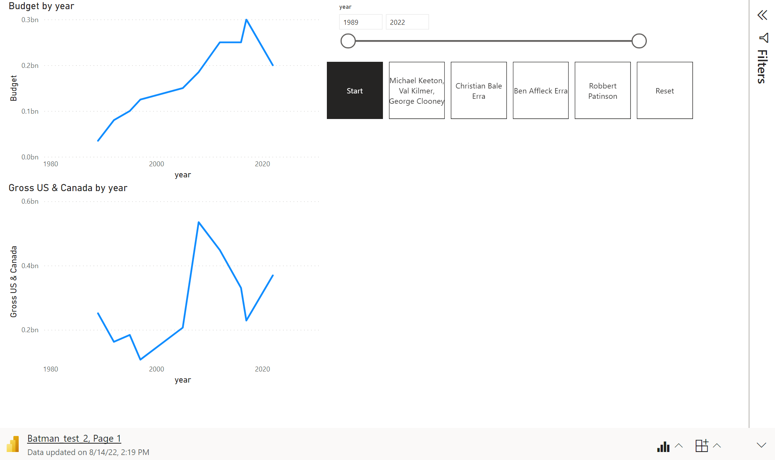

Slide 3
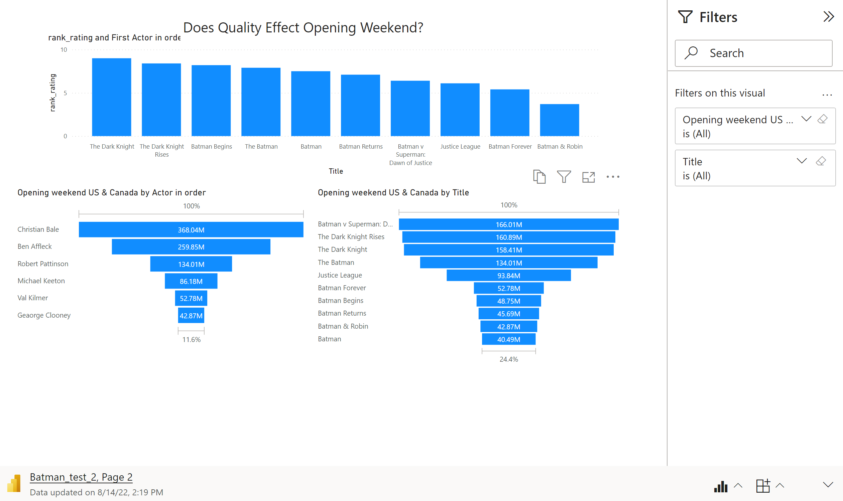

Slide 4
